Slide 1

Requirements Decomposition
Notes:
‹#›

Slide 2
The Future of Software Engineering
Automation and AI are overtaking many industries
Not just factory jobs, also lots of office jobs as well
File clerk, travel agent, maybe lawyer and accountant soon?
Q: Could software engineering be automated?
Yes, probably much of what software engineers do today
Testing, test case generation
A lot of development, possibly even design and architecture
Q: What would be the hardest part of SW Eng to automate?
It would probably be requirements engineering and requirements decomposition
Once you have clearly specified what you would like a system to do, the building of the system could be automated
So what might the future of software engineering look like?
Software systems engineering
Requirements engineering and decomposition
Declarative programming

Slide 3
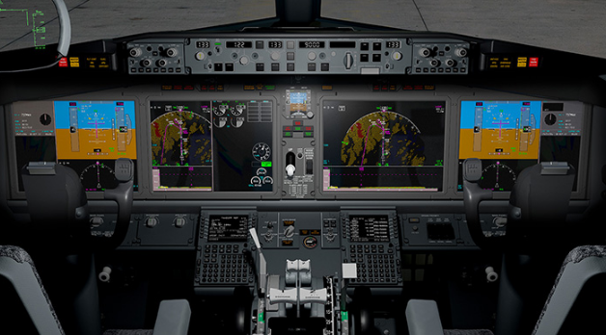
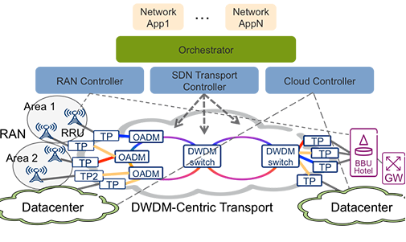
Large and Critical Systems
Formal requirements are most often used in large and critical systems (not so much in others)
Military, Automotive, Aerospace, Telecom, etc.
Requirements in these systems are broken down (“decomposed”) until useful for design and code
Source: ericsson.com
Source: boeing.com

Slide 4
Types of Decomposition
Flow-down
Assigning requirements to appropriate subsystem(s) in order to fulfill a system requirement
An architectural effort
Refinement
Ensuring requirements reach level of specificity where implementation can easily follow
A requirements effort
Completion
Adding requirements to complete missing back traces from code to requirements (stipulated by some industry-specific standards)
A design or even implementation effort

Slide 5
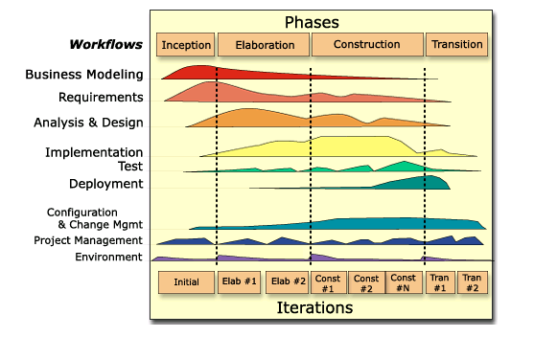
RUP - Overlap of Requirements, Design, and Implementation

Slide 6
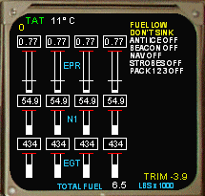
Example: A Crew Alerting System (CAS)
Part of avionics units
Alerts (text, audio) based on current conditions
Often with Engine Indication System (EIS) as below
Source: jsgpanels.com

Slide 7
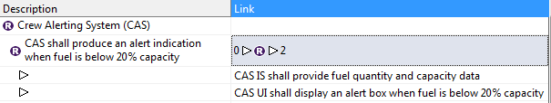
Flow-Down: System to Subsystem
During the architecture work, system requirements are assigned to the subsystems that will be involved in their implementation
System requirement assigned to subsystem or higher level subsystem requirement assigned to lower level subsystem
Often means assigning requirements to teams for further refinement
Often not refined (much) in the flow down, just assigned
CAS Example:
Information Service (IS) Subsystem
User Interface (UI) Subsystem

Slide 8
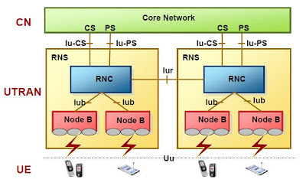
Flow-Down: Budget Allocation
Sometimes flow-down involves making resource or performance budget allocations (constraints)
Example: Radio Access Network of a cell system comprised of a Node B and Radio Network Controller (RNC)
The Radio Access Network shall setup a call within 1.2 sec
The Node B SW shall alloc transmission resources for a call within 800 ms
The RNC SW shall alloc network resources for a call within 400 ms
Source: teletopix.org

Slide 9
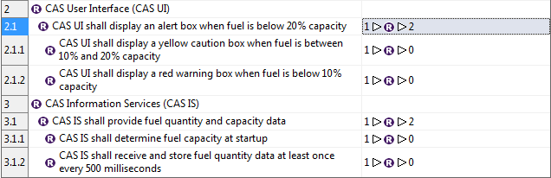
Refinement: Requirements Hierarchy
Refine the requirements to the point where design and implementation follows easily
Where we make the actual handoff from requirements to design and implementation
Refinement can provide additional information or constraints necessary for implementation
CAS Example:

Slide 10

Completion: Justifying Code
In some industries (e.g. aerospace) every piece of code must back trace to a requirement
It must be clear why every piece of code exists
Some code is more generic and don’t easily trace from a specific user requirement
e.g. common file handling code (file open, file read)
Requirements are added to clarify why the code exists, but they don’t trace back to user reqs
File_ops.cpp
File_intf.cpp
…

Slide 11
Warning: Watch out for “Derived”
Requirements terminology not always consistent between standards, sometimes is confusing
“Derived” requirements can mean flow-down and refinement requirements
Trace from higher level requirements
Military (DAU), CMMI
“Derived” requirements can mean completion requirements
Do not trace from higher level requirements
Aerospace (DO-178C), SEBOK

Slide 12
Requirements: Not How, and Not Just What
We often approach requirements exclusively at inception and elaboration
We also emphasize that requirements engineering is specifying what to build, not how to build it
However, for large systems like in defense and aviation, requirements often answer another question—Why?
Why?
After decomposition and tracing, the requirements often provide a starting place for determining why a system is what it is
Often used during
Customer Delivery
Maintenance
Evolution

Slide 13
Summary
Formal requirements most often used in large and critical systems, which often need decomposition
Types of decomposition
Flow-down
Refinement
Completion
Decomposition activity produces traces between requirements
Watch out for inconsistent requirements terminology
Decomposition and tracing provide a full picture of how the entire set of software deliverables fit together

